Slide 1
BOX JUMPER!
RYAN BOYD
JEROMY BAMO
CS-380 PROJECT
DR. SWANSON

Slide 2
HOW TO PLAY:
OBJECTIVE:
Obtain a high score by jumping over the bricks.
HOW THE GAME WORKS:
Jump over the bricks to stay alive.
If the player runs into a brick, the game is over.
The score system is based on time played in seconds.

Slide 3
HOW TO START
BOX JUMPER

Slide 4
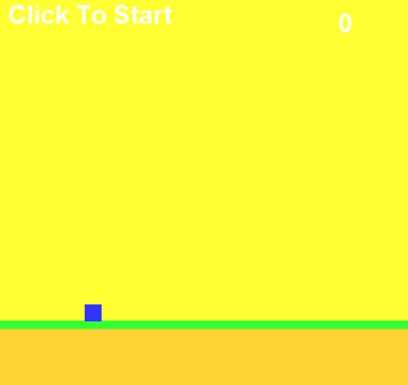
Launch the game and make sure the brick.png is on the desktop.
Next you will see on the top left corner “Click To Start.”
* Once your score is higher than 1, the “Click To Start” will go away.
Press the spacebar in order to jump over the bricks.

Slide 5
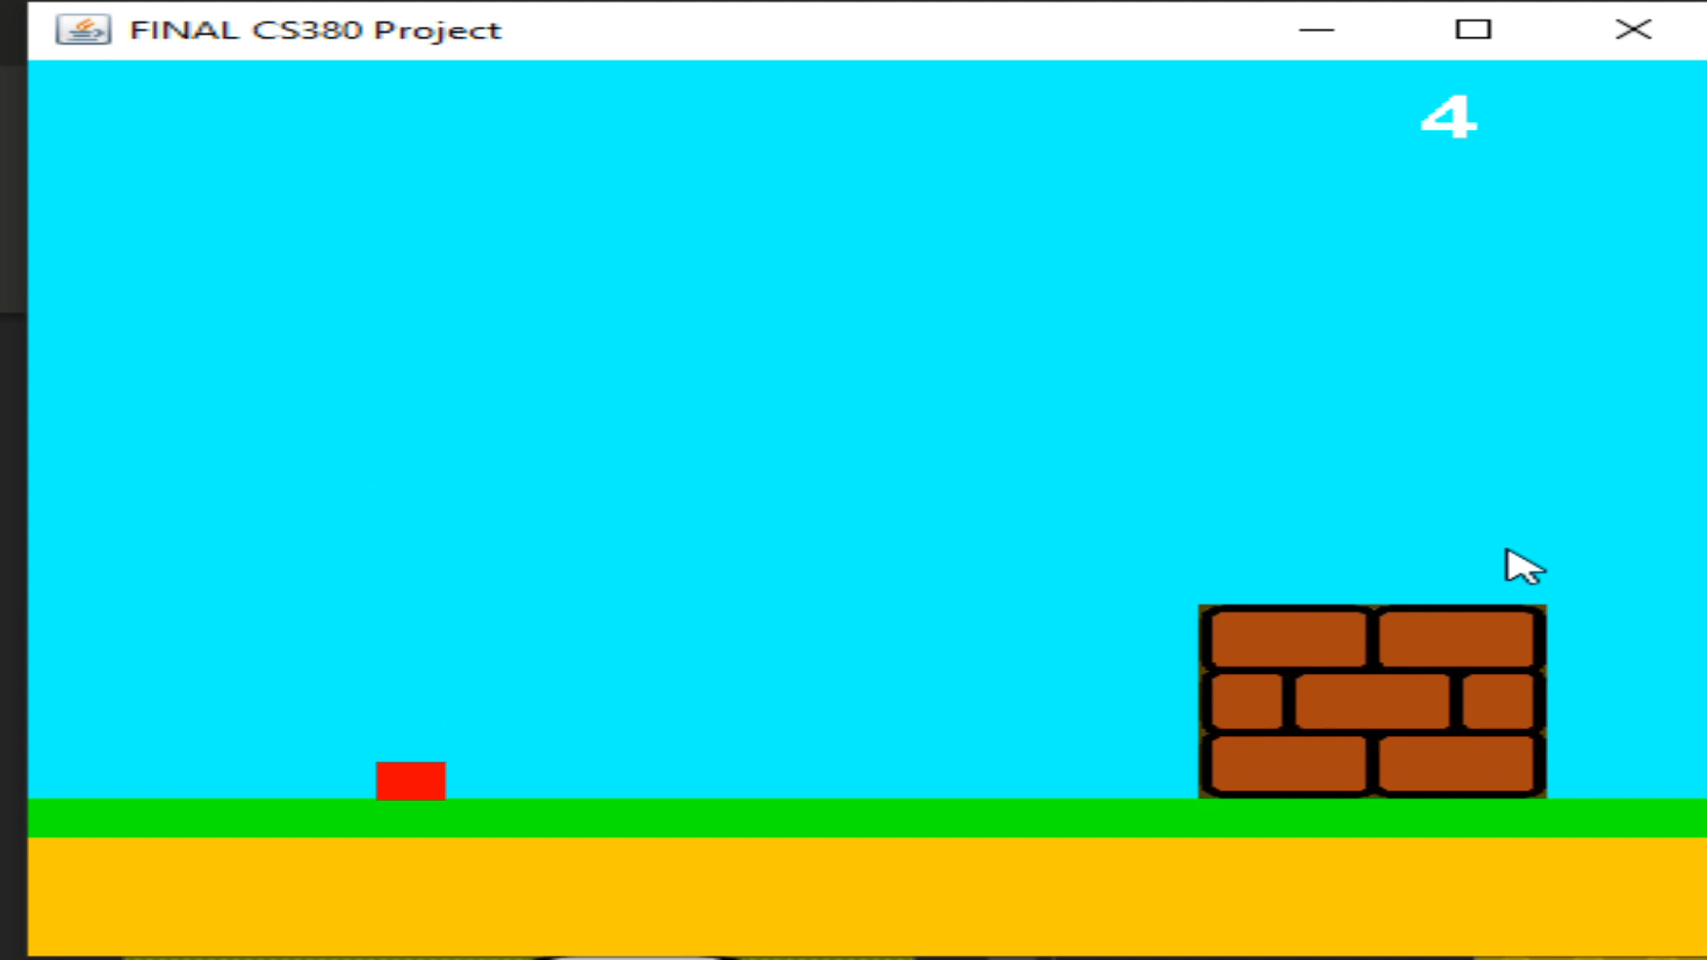
GETTING THE SCORE!
Avoid the brick by pressing the spacebar to jump over them.
You can also use your mouse by clicking to jump over the bricks.

Slide 6
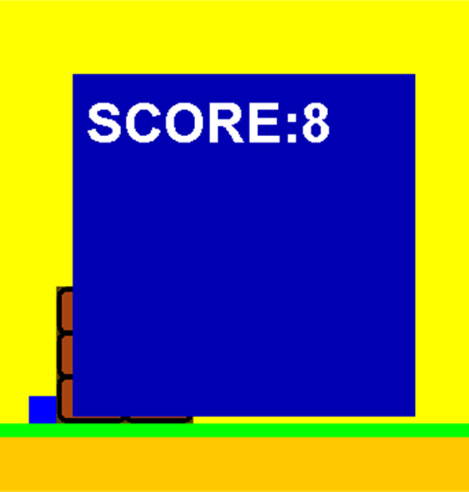
game
OVER!
If you run into a brick, the game will be over.
Score will be displayed on the screen.

Slide 7
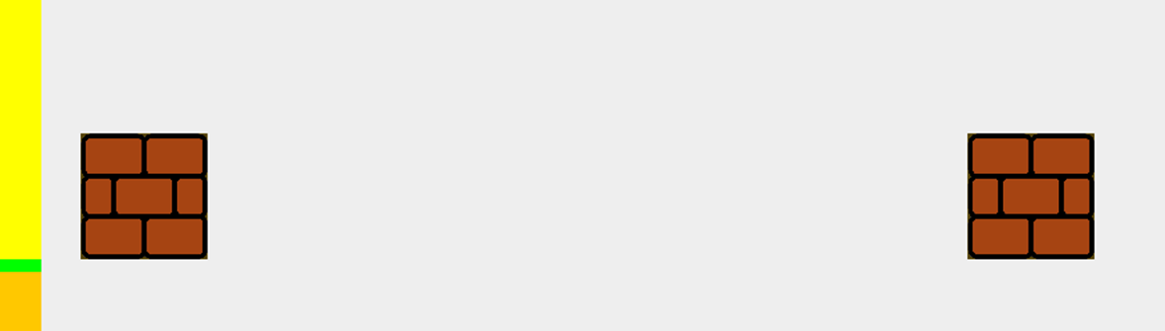
ADDITIONAL INFORMATION:
The space between every brick is randomized. Please be sure to pay attention because if you jump too early or too late, the game may be over.

Slide 8
CODE EXPLANATION

Slide 9
CODE EXPLANATION cont…

Slide 10
LIVE
DEMONSTRATION

Slide 11
QUESTIONS?
COMMENTS?
CONCERNS?

